Slide 1
Data File Handling

Slide 2
Topics
Data File operations
Opening and closing of files,
Modes of file
File stream functions,
Reading/Writing of files
Sequential access and random access file processing,
Binary file operations
Classes and file operations,
Structures and file operation

Slide 3
Introduction

Slide 4
Files
A file is a collection of related data stored in a particular area on the disk.
In C++, Programs can be designed to perform the read and write operations on these files
A program involves either or both of following kinds of data communication:
Data transfer between the console unit and the program
Data transfer between the program and a disk file

Slide 5
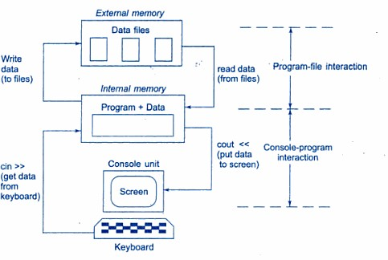
Console-program-file interaction

Slide 6
Why to use Files
Convenient way to deal large quantities of data.
Store data permanently (until file is deleted).
Avoid typing data into program multiple times.
Share data between programs.
We need to know:
how to "connect" file to program how to tell the program to read data how to tell the program to write data error checking and handling EOF

Slide 7
Opening and closing of files

Slide 8
Opening and closing a file
If we want to use a disk file, we need to decide the following things:
Suitable name for the file
Data type and structure
Purpose
Opening Method

Slide 9
Filename
The file name is a string of characters that make up a valid filename for the operating system.
It has two parts, a primary name and an optional period with extension
Example:
Input.data
Test.doc

Slide 10
Opening a file
For opening a file, we must first create a file stream and then link it to the filename.
A file stream can be defined using the classes ifstream, ofstream and fstream that are contained in the header file fstream
A file can be opened in two ways:
Using a constructor function of the class
Using the member function open() of the class

Slide 11
Opening files using constructor
Constructor is used to initialize an object while it is being created. Here, a filename is used to initialize the file stream object.
This involves following steps:
Create a file stream object to manage the stream using appropriate class
Initialize the file object with the desired filename.

Slide 12
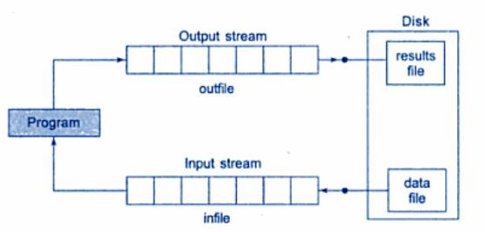
Opening files using constructor
For example:
ofstream outfile(“results”); // output only
This creates outfile as an ofstream object that manages the output stream.
This statement opens the file results and attaches it to the output stream outfile

Slide 13
Opening files using constructor
The following statement declares infile as an ifstream object and attaches it to the file data for reading
ifstream infile (“data”); //input only
The program may contain statements like: outfile<<total;
outfile<<sum; infile>>number; infile>>string

Slide 14
Opening files using constructor
We can also use same file for both reading and writing data
Program1
……..
ofstream outfile(“salary”); //creates outfile and connects “salary” to it
……...
Program2
……….
ifstream infile(“salary”); //creates infile and connects “salary” to it
………

Slide 15
Opening files using constructor
Instead of using two program, one for writing data and another for reading data, we can use single program to do both operations on file.
…..
outfile.close(); //disconnect salary file from outfile
ifstream infile(“salary”); // and connect to infile
…..
…..
infile.close();

Slide 16
Program for Writing into file
#include<iostream> #include<fstream> using namespace std; int main()
{
ofstream of("result.txt"); of<<"hello";
of.close();
cout<<"data saved\n";
}

Slide 17
Program to Read from the file
#include<iostream>
#include<fstream>
using namespace std; int main()
{
char s[10];
ifstream inf("result.txt");
inf>>s;
inf.close(); cout<<s;
}

Slide 18
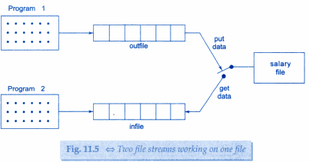
Two file streams working on same file
Program1
………………
……………….
ofstream outfile(“salary”);
……………………
…………………..
Program2
…………………
…………………..
ifstream infile(“salary”);
……………………
…………………….

Slide 19
Program for reading and writing
#include<iostream>
#include<fstream>
using namespace std;
int main()
{
char s[30];
ofstream of("result.txt");
of<<"welcome";
of.close();
cout<<"data saved\n";
ifstream inf("result.txt");
inf>>s;
cout<<s;
inf.close();
return 0;
}
Notes:
#include<iostream>
#include<fstream>
using namespace std;
int main()
{
char s[30];
ofstream of("result");
of<<"hello";
of.close();
cout<<"data saved\n";
ifstream inf(“result”);
inf>>s;
cout<<s;
inf.close();
return 0;
}

Slide 20
Opening files using open()
This function is used to open multiple files that uses same stream object.
Syntax:-
file_stream class stream_object; stream_object.open(“filename”);

Slide 21
Example
ofstream outfile; outfile.open(“Country.txt”);
…………………..
………………….. outfile.close(); outfile.open(“Capital.txt”);
…………………….
…………………..
outfile.close();

Slide 22
Program for write into file
#include<iostream>
#include<fstream>
using namespace std;
int main()
{
ofstream fout;
fout.open("result.txt");
fout<<"india\n";
fout<<"USA\n";
fout<<"UK\n";
fout.close();
fout.open("result1.txt");
fout<<"Delhi\n";
fout<<"Washington\n";
fout<<"Londan\n";
fout.close();
}

Slide 23
Program for reading from file
#include<iostream>
#include<fstream>
using namespace std;
int main()
{
const int n=80;
char s[n];
ifstream fin;
fin.open("result.txt");
while(fin)
{
fin.getline(s,n);
cout<<s;
}
fin.close();
fin.open(“result1.txt");
while(fin)
{
fin.getline(s,n);
cout<<s;
}
fin.close();
}

Slide 24
Detecting end-of-file
This condition is necessary for preventing any further attempt to read data from the file.
while(fin)
here fin is ifstream object which returns a value 0 if any error occur in file including end-of-file condition.
if(fin1.eof()!=0)
{ exit(1);}
eof() is a member function of class ios. It returns non zero value if the end-of-file(eof) condition is encountered and zero otherwise.

Slide 25
MCQ1
Which header file is required to use file I/O operations?
<ifstream>
<ostream>
<fstream>
<iostream>

Slide 26
Solution
Which header file is required to use file I/O operations?
<ifstream>
<ostream>
<fstream>
<iostream>

Slide 27
MCQ 2
Which of the following is used to create an output stream?
ofstream
ifstream
iostream
fsstream

Slide 28
Solution
Which of the following is used to create an output stream?
ofstream
ifstream
iostream
fsstream

Slide 29
Modes of file

Slide 30


File modes
General form of open() with 2 arguments is:
Specifies purpose for which file is opened
Prototype of member function contains default values as:

Slide 31
File modes
Parameter | Meaning
ios::app | Append to end-of-file
ios::ate | Go to end of file on opening
ios::binary | Binary file
ios::in | Open file for reading only
ios::nocreate | Open fail if file does not exist
ios::noreplace | Open fail if file already exist
ios::out | Open file for writing only
ios::trunc | Delete contents of file

Slide 32
Examples
1. ofstream fileout; fileout.open(“hello”,ios::app);
2) int main()
{
fstream infile;
Infile.open(“data_file”, ios::in|ios::out)
}

Slide 33
append mod
#include<iostream>
#include<fstream>
using namespace std;
int main()
{
char s[30];
ofstream fileout;
ifstream filein;
fileout.open("data",ios::app);
fileout<<"hello world";
fileout.close();
filein.open("data",ios::in);
filein.getline(s,30);
cout<<s;
}

Slide 34
MCQ 1
What is the use of ios::trunc mode?
To open a file in input mode
To open a file in output mode
To truncate an existing file to half
To truncate an existing file to zero

Slide 35
Solution
What is the use of ios::trunc mode?
To open a file in input mode
To open a file in output mode
To truncate an existing file to half
To truncate an existing file to zero

Slide 36
MCQ 2
Which of the following is the default mode of the opening using the ofstream class?
ios::in
ios::out
ios::app
ios::trunc

Slide 37
Solution
Which of the following is the default mode of the opening using the ofstream class?
ios::in
ios::out
ios::app
ios::trunc

Slide 38
MCQ 3
What is the return type open() method?
int
char
bool
float

Slide 39
Solution
What is the return type open() method?
int
char
bool
float

Slide 40
File stream functions

Slide 41
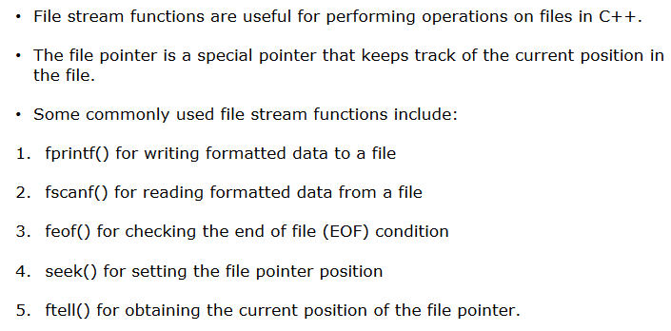
File stream functions

Slide 42
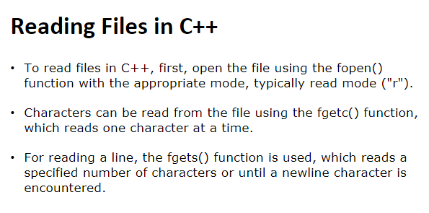

Slide 43
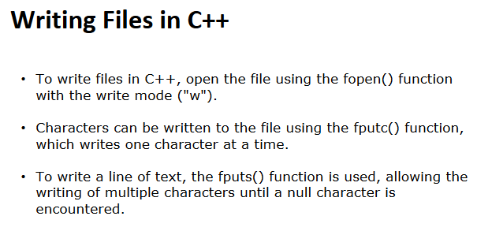

Slide 44
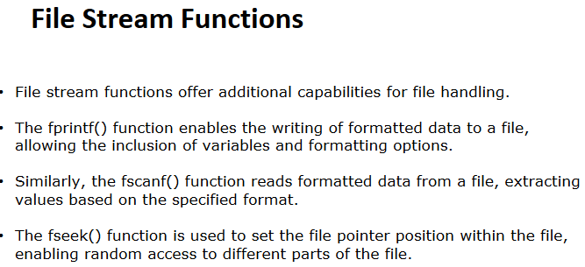

Slide 45
Sequential access file processing

Slide 46
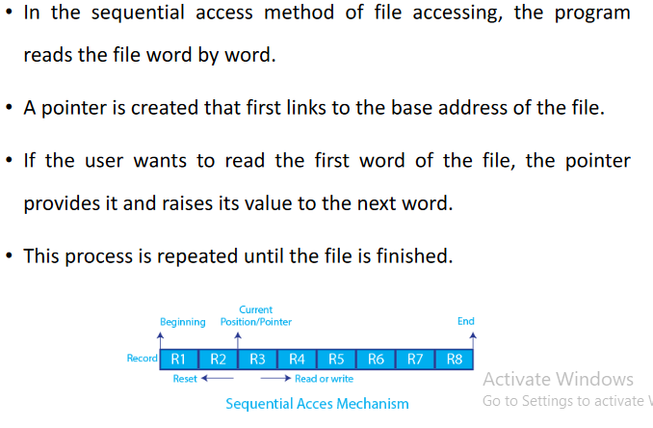
Sequential access file processing

Slide 47
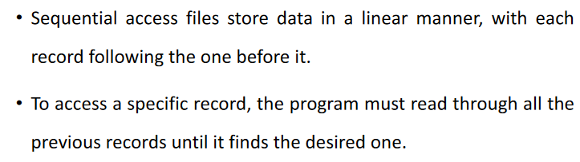
Sequential access file processing

Slide 48
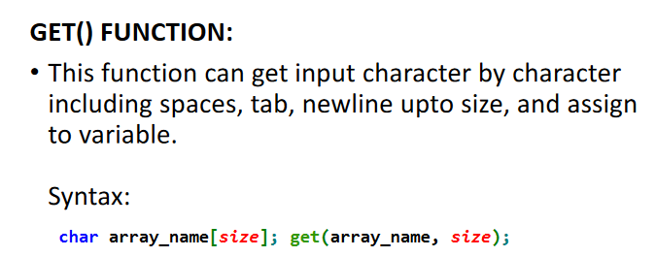

Slide 49
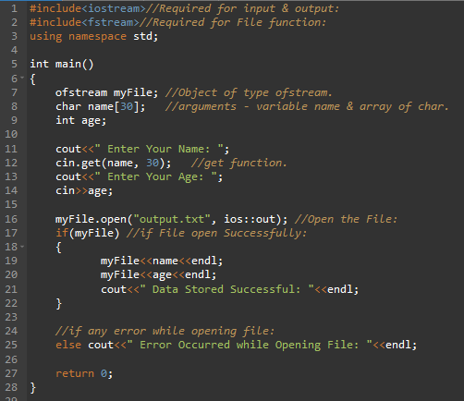
Example get() function

Slide 50
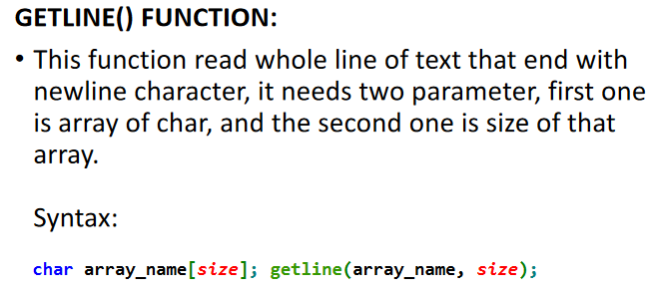

Slide 51
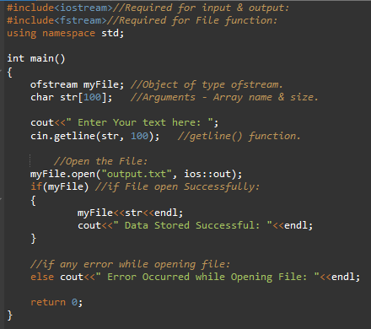
getline () example

Slide 52
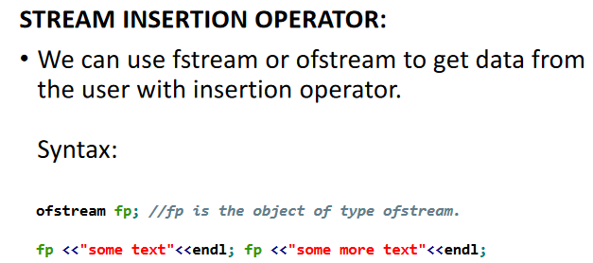

Slide 53
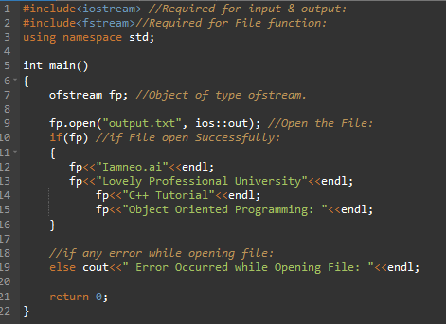

Slide 54
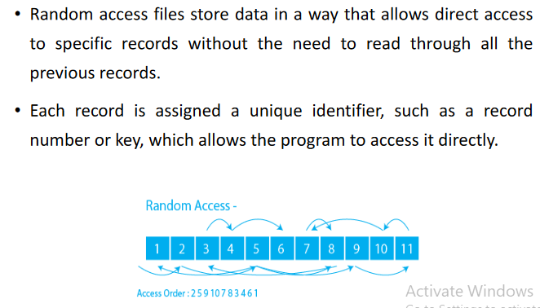
Random access

Slide 55
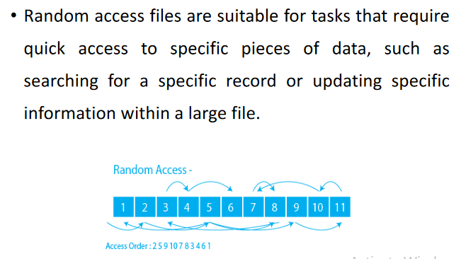
Random access

Slide 56
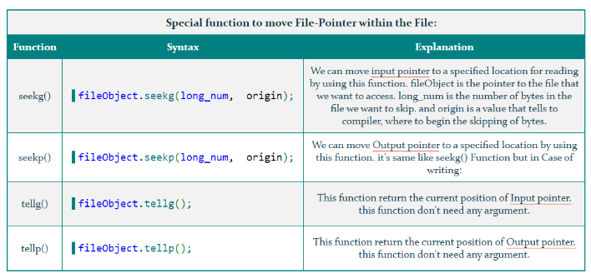

Slide 57
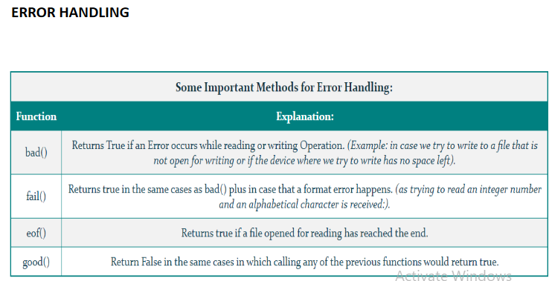

Slide 58
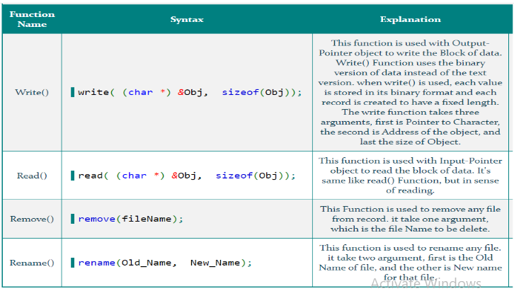
Some more functions

Slide 59
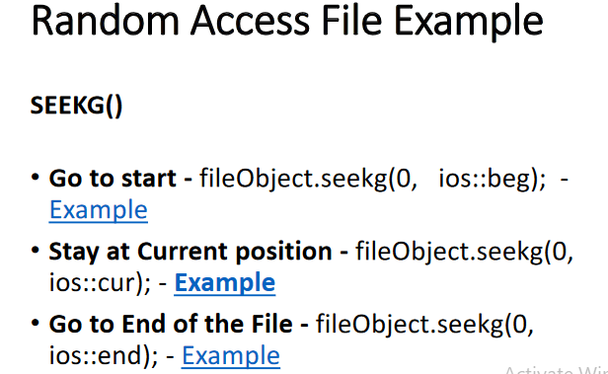

Slide 60
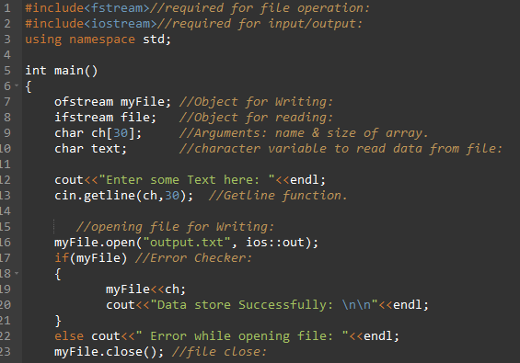
Seekg: Program 1

Slide 61
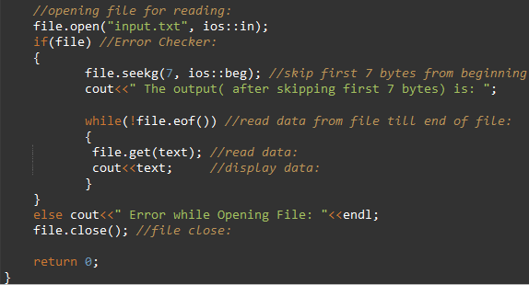
Seekg: Program 1

Slide 62
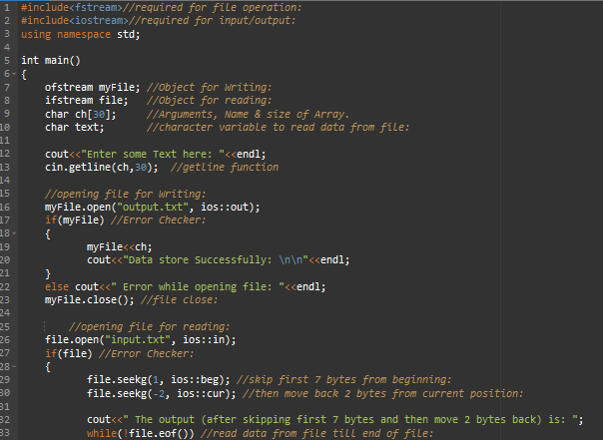
Seekg: Program 2

Slide 63
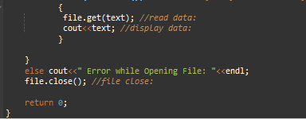
Seekg: Program 2

Slide 64
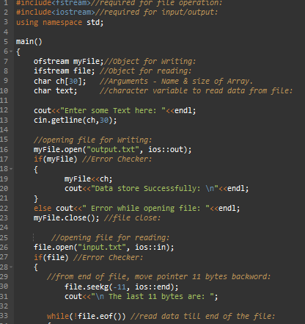
Seekg: Program 3

Slide 65
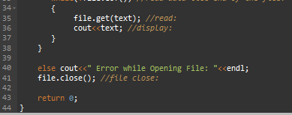
Seekg: Program 3

Slide 66
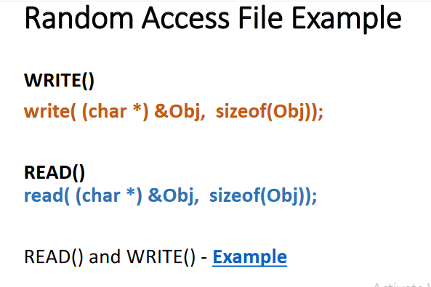

Slide 67
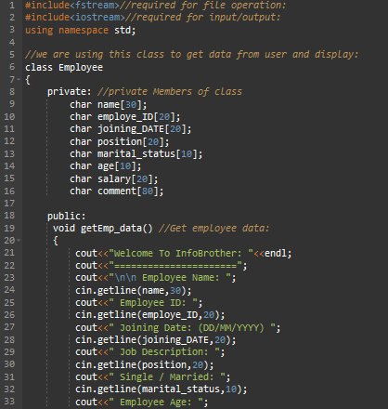

Slide 68


Slide 69
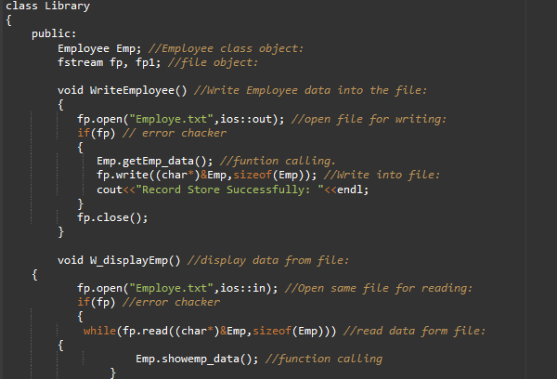

Slide 70
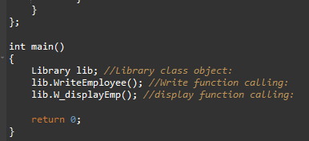

Slide 71
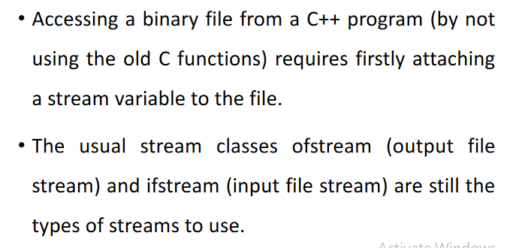
Binary file operation

Slide 72
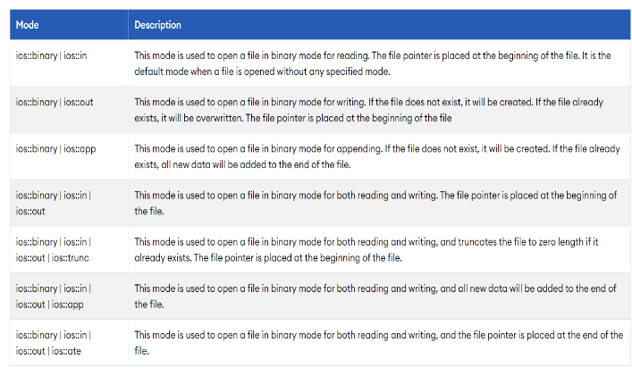

Slide 73
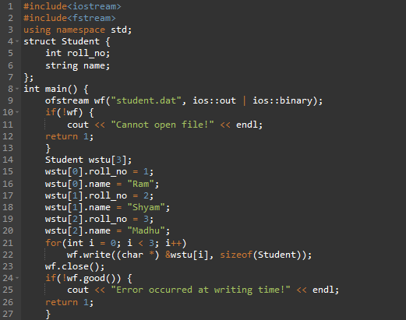
Binary file operation example

Slide 74
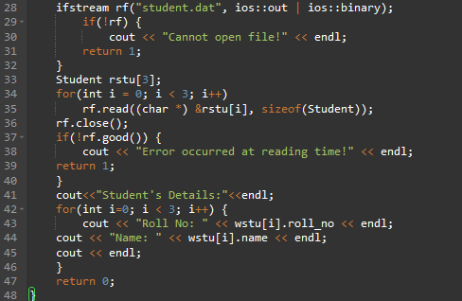
Binary file operation example

Slide 75
MCQ 1
Which function is used in C++ to get the current position of file pointer in a file?
tellp()
get_pos()
get_p()
tell_pos()

Slide 76
Solution
Which function is used in C++ to get the current position of file pointer in a file?
tellp()
get_pos()
get_p()
tell_pos()

Slide 77
MCQ 2
Which function is used to reposition the file pointer?
moveg()
seekg()
changep()
go_p()

Slide 78
solution
Which function is used to reposition the file pointer?
moveg()
seekg()
changep()
go_p()

